Slide 1
Technology Lunch Series: sustaining technological knowledge and relationships
Emily Brennan, MLIS
USC Norris Medical Library

Slide 2
About the Technology Lunch Series
Series of monthly sessions intended to teach patrons about less academic, technology-related topics
Taught by Education/Reference librarians and Emerging Technologies Librarian
Audience: anyone is welcome to attend!
  Audience often blend of students, staff and faculty
  Varying levels of expertise
Sessions occur during the lunch hour
  Free pizza lunch!

Slide 3
Marketing
Marketing
New@Norris Blog
Facebook
Twitter
Email
Flyers with
QR codes
Faculty Committees
Class announcements
Public computer desktop ads
Notes:
Blog: New@Norris blog on homepage
160 subscribe to email alerts
Facebook: 230 “like” us
Twitter: 125 followers

Slide 4
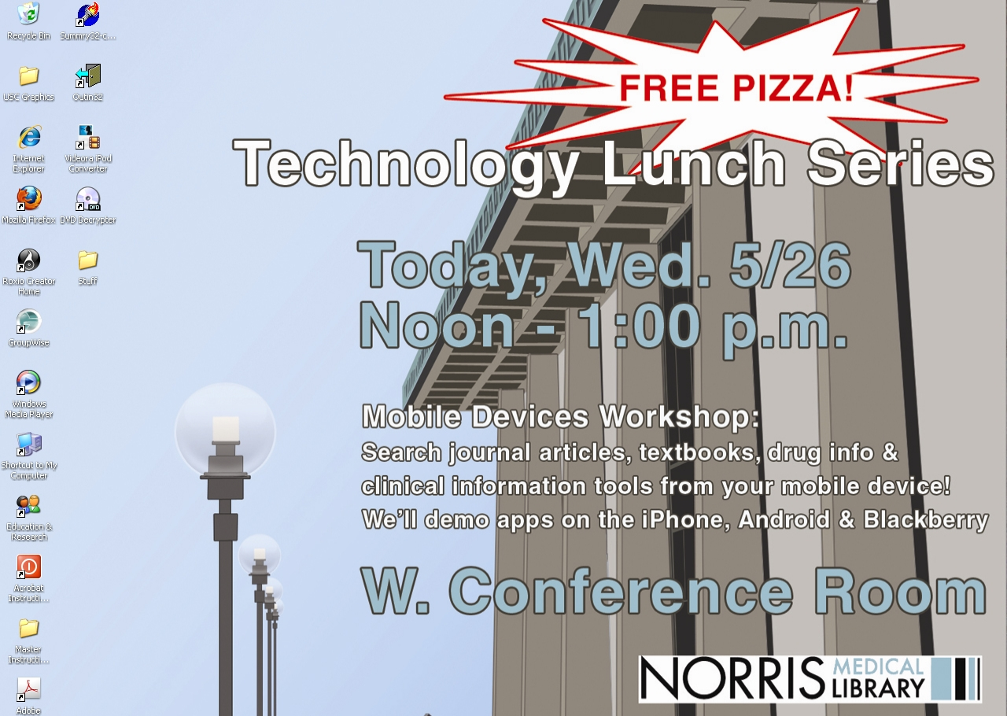

Slide 5
Session Topics
Topics
Mobile Devices
Twitter
Google Reader
Skype
Tools to edit PDFs
Tech Timesavers
PowerPoint
Delicious & Diigo

Slide 6
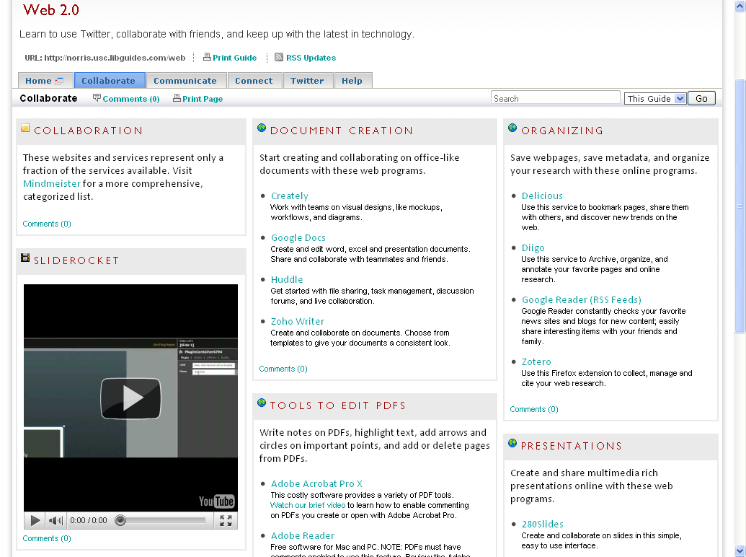

Slide 7
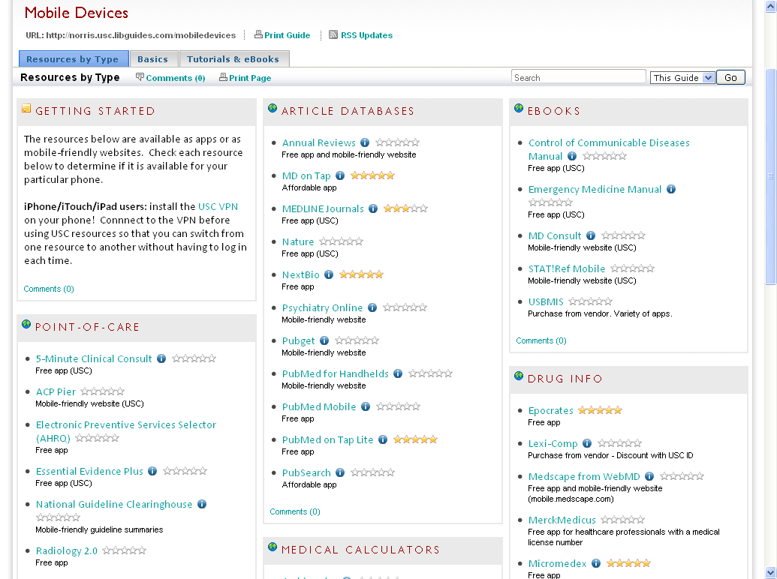

Slide 8
Tips for a Successful Session
Know your topic…as well as you can
Ask audience how they learned about session
Learn about your audience (status, department, what they already know, how they will use the information you teach)
Keep it organized yet casual
Encourage discussion
Create supplemental material, e.g., LibGuides
Allow plenty of time for Q&A, hands-on

Slide 9
Future Plans
Future session topics:
  More focus on mobile devices
    Discipline-specific sessions and device-specific sessions
  QR Codes
Enhancing the session:
  Tape sessions
  Create short tutorials based on sessions

Slide 10
Benefits
Sustains librarians’ knowledge and use of technology
  compels librarians to keep up-to-date
  instructor often learns of new technologies through attendees
Sessions have led to collaboration, consultation and instruction opportunities
Develops relationships with otherwise unknown user groups
Library is increasingly viewed as the technology hub of the health sciences campus

Slide 11
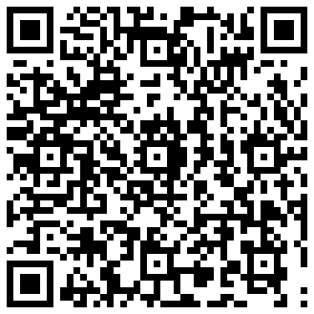
Questions?
Emily Brennan
ebrennan@usc.edu
323.442.1124

